Slide 1




Slide 2
Shahriar M. oishik
Maria nur
2023-3-60-073
2023-3-60-551
Department of CSE
Department of CSE
Afra sultana
Ahmed
2023-3-60-300
2023-3-60-128
Department of CSE
Department of CSE

Slide 3
INTRODUCTION

Slide 4
INTRODUCTION
Partial differential equation (PDE)
a differential equation involving partial derivates of one or more dependent variables
with respect to more than one independent variables

Slide 5
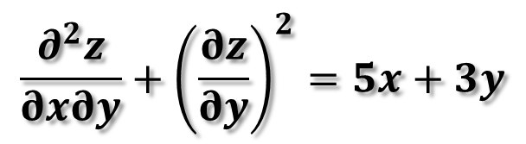
INTRODUCTION
Partial differential equation (PDE)
a differential equation involving partial derivates of one or more dependent variables
with respect to more than one independent variables
$$\frac{∂^{2}z}{∂x∂y}+{\left(\frac{∂z}{∂y}\right)}^{2}=5x+3y$$
Example:

Slide 6
Methods to generate P.D.E
Elimination of Arbitrary Constants
Elimination of Arbitrary Functions

Slide 7
Methods to generate P.D.E
Elimination of Arbitrary Constants
Elimination of Arbitrary Functions
Eliminating Arbitrary Functions

Slide 8
Elimination of Arbitrary Constants

Slide 9
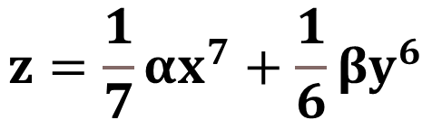
Elimination of Arbitrary Constants
Procedure
$$z=\frac{1}{7}αx^{7}+\frac{1}{6}βy^{6}$$
Equation:

Slide 10
Elimination of Arbitrary Constants
Procedure
$$z=\frac{1}{7}αx^{7}+\frac{1}{6}βy^{6}$$
Equation:
(i)

Slide 11
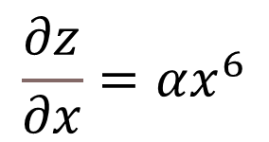
Elimination of Arbitrary Constants
Procedure
$$z=\frac{1}{7}αx^{7}+\frac{1}{6}βy^{6}$$
Equation:
(i)
Partial differentiating the equation (i) with respect to x,
$$\frac{∂z}{∂x}=αx^{6}$$

Slide 12
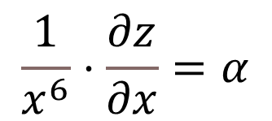
Elimination of Arbitrary Constants
Procedure
$$z=\frac{1}{7}αx^{7}+\frac{1}{6}βy^{6}$$
Equation:
(i)
Partial differentiating the equation (i) with respect to x,
$$\frac{∂z}{∂x}=αx^{6}$$
So,
$$\frac{1}{x^{6}}⋅\frac{∂z}{∂x}=α$$

Slide 13
Elimination of Arbitrary Constants
Procedure
$$z=\frac{1}{7}αx^{7}+\frac{1}{6}βy^{6}$$
Equation:
(i)
Partial differentiating the equation (i) with respect to x,
$$\frac{∂z}{∂x}=αx^{6}$$
So,
$$\frac{1}{x^{6}}⋅\frac{∂z}{∂x}=α$$

Slide 14



Elimination of Arbitrary Constants
Procedure
$$z=\frac{1}{7}αx^{7}+\frac{1}{6}βy^{6}$$
(i)
Equation:
Partial differentiating the equation (i) with respect to x,
$$\frac{∂z}{∂x}=αx^{6}$$
So,
$$\frac{1}{x^{6}}⋅\frac{∂z}{∂x}=α$$

Slide 15
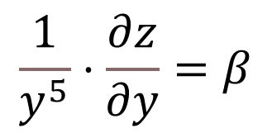
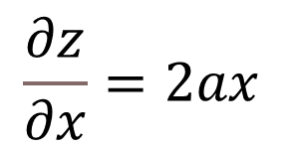
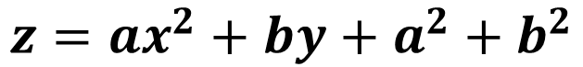
Elimination of Arbitrary Constants
Procedure
Equation:
$$z=ax^{2}+by+a^{2}+b^{2}$$
(i)
Partial differentiating the equation (i) with respect to x,
$$\frac{∂z}{∂x}=2ax$$
So,
$$\frac{1}{x^{6}}⋅\frac{∂z}{∂x}=α$$
Similarly, By partial differentiating Equation (i) with respect to y we get,
$$\frac{1}{y^{5}}⋅\frac{∂z}{∂y}=β$$

Slide 16
Elimination of Arbitrary Constants
Procedure
Equation:
$$z=ax^{2}+by+a^{2}+b^{2}$$
(i)
Partial differentiating the equation (i) with respect to x,
$$\frac{∂z}{∂x}=2ax$$
So,
$$\frac{1}{x^{6}}⋅\frac{∂z}{∂x}=α$$
Similarly, By partial differentiating Equation (i) with respect to y we get,
$$\frac{1}{y^{5}}⋅\frac{∂z}{∂y}=β$$

Slide 17
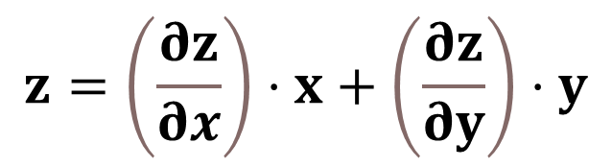
Elimination of Arbitrary Constants
Procedure
Equation:
$$z=ax^{2}+by+a^{2}+b^{2}$$
(i)
Partial differentiating the equation (i) with respect to x,
$$\frac{∂z}{∂x}=2ax$$
So,
$$\frac{1}{x^{6}}⋅\frac{∂z}{∂x}=α$$
Similarly, By partial differentiating Equation (i) with respect to y we get,
$$\frac{1}{y^{5}}⋅\frac{∂z}{∂y}=β$$
By substituting Value of $α$and $β$in the equation (i), We get,
$$z=\left(\frac{∂z}{∂x}\right)⋅x+\left(\frac{∂z}{∂y}\right)⋅y$$

Slide 18
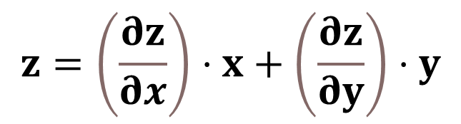
Elimination of Arbitrary Constants
Procedure
Equation:
$$z=ax^{2}+by+a^{2}+b^{2}$$
(i)
Partial differentiating the equation (i) with respect to x,
$$\frac{∂z}{∂x}=2ax$$
So,
$$\frac{1}{x^{6}}⋅\frac{∂z}{∂x}=α$$
Similarly, By partial differentiating Equation (i) with respect to y we get,
$$\frac{1}{y^{5}}⋅\frac{∂z}{∂y}=β$$
By substituting Value of $α$and $β$in the equation (i), We get,
$$z=\left(\frac{∂z}{∂x}\right)⋅x+\left(\frac{∂z}{∂y}\right)⋅y$$
This equation is a partial differential equation generated from equation (i)
by using Elimination of arbitrary constants

Slide 19
Elimination of Arbitrary Functions

Slide 20
Elimination of Arbitrary FUNCTIONS
Procedure

Slide 21
Elimination of Arbitrary FUNCTIONS
Procedure
In some cases, an equation may contain arbitrary functions rather than constants,
therefore by eliminating arbitrary functions from the given equation we can derive the
corresponding partial differential equation.

Slide 22
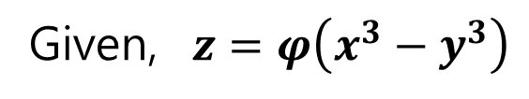
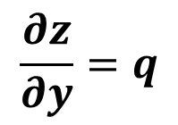
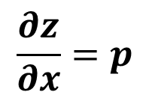
Elimination of Arbitrary FUNCTIONS
Procedure
In some cases, an equation may contain arbitrary functions rather than constants,
therefore by eliminating arbitrary functions from the given equation we can derive the
corresponding partial differential equation.
Example:
Given, $z=φ\left(x^{3}−y^{3}\right)$
(i)
$z$ is a function of $x$ and $y$, therefore we can denote,
$$\frac{∂z}{∂x}=p$$
$$\frac{∂z}{∂y}=q$$

Slide 23
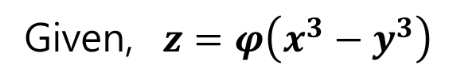
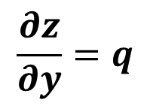
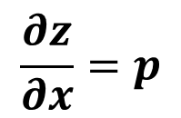
Elimination of Arbitrary FUNCTIONS
Procedure
In some cases, an equation may contain arbitrary functions rather than constants,
therefore by eliminating arbitrary functions from the given equation we can derive the
corresponding partial differential equation.
Example:
Given, $z=φ\left(x^{3}−y^{3}\right)$
(i)
$z$ is a function of $x$ and $y$, therefore we can denote,
$$\frac{∂z}{∂x}=p$$
$$\frac{∂z}{∂y}=q$$

Slide 24
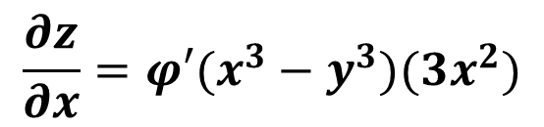
Elimination of Arbitrary FUNCTIONS
Procedure
In some cases, an equation may contain arbitrary functions rather than constants,
therefore by eliminating arbitrary functions from the given equation we can derive the
corresponding partial differential equation.
Example:
Given, $z=φ\left(x^{3}−y^{3}\right)$
(i)
$z$ is a function of $x$ and $y$, therefore we can denote,
$$\frac{∂z}{∂x}=p$$
$$\frac{∂z}{∂y}=q$$
Differentiating equation (i) with respect to x we get,
$$\frac{∂z}{∂x}=φ′(x^{3}−y^{3})(3x^{2})$$

Slide 25
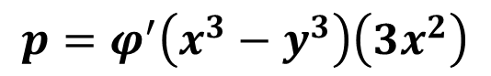
Elimination of Arbitrary FUNCTIONS
Procedure
In some cases, an equation may contain arbitrary functions rather than constants,
therefore by eliminating arbitrary functions from the given equation we can derive the
corresponding partial differential equation.
Example:
Given, $z=φ\left(x^{3}−y^{3}\right)$
(i)
$z$ is a function of $x$ and $y$, therefore we can denote,
$$\frac{∂z}{∂x}=p$$
$$\frac{∂z}{∂y}=q$$
Differentiating equation (i) with respect to x we get,
$$\frac{∂z}{∂x}=φ′(x^{3}−y^{3})(3x^{2})$$
$$p=φ^{′}\left(x^{3}−y^{3}\right)\left(3x^{2}\right)$$
(ii)

Slide 26
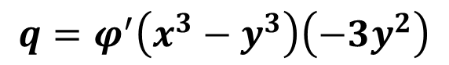
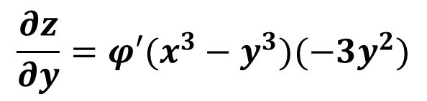
Elimination of Arbitrary FUNCTIONS
Procedure
In some cases, an equation may contain arbitrary functions rather than constants,
therefore by eliminating arbitrary functions from the given equation we can derive the
corresponding partial differential equation.
Example:
Given, $z=φ\left(x^{3}−y^{3}\right)$
(i)
$z$ is a function of $x$ and $y$, therefore we can denote,
$$\frac{∂z}{∂x}=p$$
$$\frac{∂z}{∂y}=q$$
Differentiating equation (i) with respect to x we get,
$$\frac{∂z}{∂x}=φ′(x^{3}−y^{3})(3x^{2})$$
$$p=φ^{′}\left(x^{3}−y^{3}\right)\left(3x^{2}\right)$$
(ii)
Similarly, Differentiating equation (i) with respect to y we get,
$$\frac{∂z}{∂y}=φ′(x^{3}−y^{3})(−3y^{2})$$
$$q=φ^{′}\left(x^{3}−y^{3}\right)\left(−3y^{2}\right)$$
(iii)

Slide 27
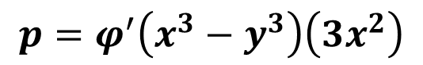
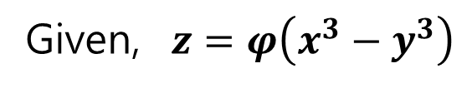
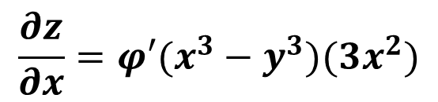
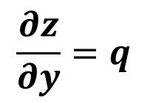
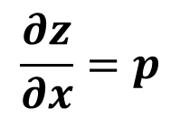
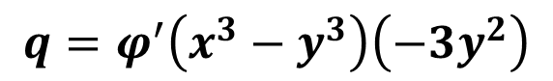
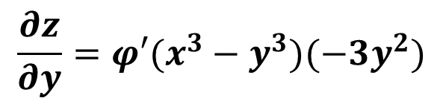
Given, $z=φ\left(x^{3}−y^{3}\right)$
(i)
$z$ is a function of $x$ and $y$, therefore we can denote,
$$\frac{∂z}{∂x}=p$$
$$\frac{∂z}{∂y}=q$$
Differentiating equation (i) with respect to x we get,
$$\frac{∂z}{∂x}=φ′(x^{3}−y^{3})(3x^{2})$$
Differentiating equation (i) with respect to y we get,
$$\frac{∂z}{∂y}=φ′(x^{3}−y^{3})(−3y^{2})$$
Example:
$$p=φ^{′}\left(x^{3}−y^{3}\right)\left(3x^{2}\right)$$
(ii)
$$q=φ^{′}\left(x^{3}−y^{3}\right)\left(−3y^{2}\right)$$
(iii)

Slide 28
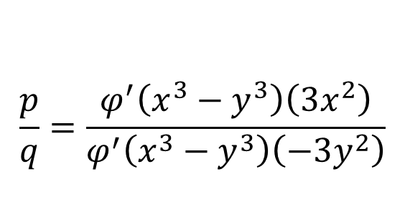
Given, $z=φ\left(x^{3}−y^{3}\right)$
(i)
$z$ is a function of $x$ and $y$, therefore we can denote,
$$\frac{∂z}{∂x}=p$$
$$\frac{∂z}{∂y}=q$$
Differentiating equation (i) with respect to x we get,
$$\frac{∂z}{∂x}=φ′(x^{3}−y^{3})(3x^{2})$$
Differentiating equation (i) with respect to y we get,
$$\frac{∂z}{∂y}=φ′(x^{3}−y^{3})(−3y^{2})$$
Example:
$$p=φ^{′}\left(x^{3}−y^{3}\right)\left(3x^{2}\right)$$
(ii)
$$q=φ^{′}\left(x^{3}−y^{3}\right)\left(−3y^{2}\right)$$
(iii)
$$\frac{p}{q}=\frac{φ^{′}\left(x^{3}−y^{3}\right)\left(3x^{2}\right)}{φ^{′}\left(x^{3}−y^{3}\right)\left(−3y^{2}\right)}$$
Dividing equation (ii) over equation (iii) we get,

Slide 29
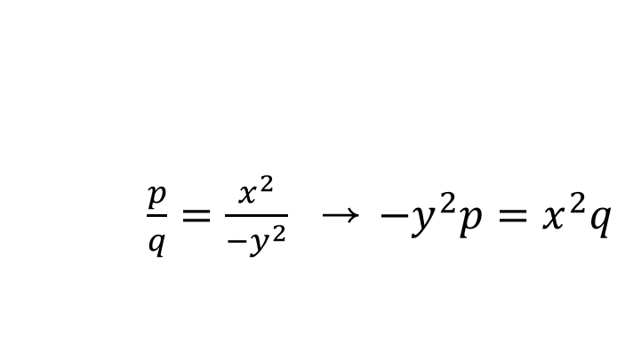
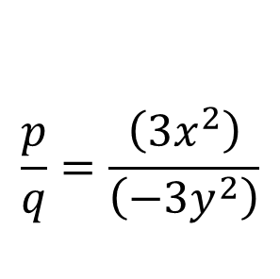
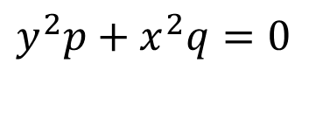
Given, $z=φ\left(x^{3}−y^{3}\right)$
(i)
$z$ is a function of $x$ and $y$, therefore we can denote,
$$\frac{∂z}{∂x}=p$$
$$\frac{∂z}{∂y}=q$$
Differentiating equation (i) with respect to x we get,
$$\frac{∂z}{∂x}=φ′(x^{3}−y^{3})(3x^{2})$$
Differentiating equation (i) with respect to y we get,
$$\frac{∂z}{∂y}=φ′(x^{3}−y^{3})(−3y^{2})$$
Example:
$$p=φ^{′}\left(x^{3}−y^{3}\right)\left(3x^{2}\right)$$
(ii)
$$q=φ^{′}\left(x^{3}−y^{3}\right)\left(−3y^{2}\right)$$
(iii)
$$\frac{p}{q}=\frac{φ^{′}\left(x^{3}−y^{3}\right)\left(3x^{2}\right)}{φ^{′}\left(x^{3}−y^{3}\right)\left(−3y^{2}\right)}$$
Dividing equation (ii) over equation (iii) we get,
$$\frac{p}{q}=\frac{\left(3x^{2}\right)}{\left(−3y^{2}\right)}$$
$\frac{p}{q}=\frac{x^{2}}{−y^{2}}$ → $−y^{2}p=x^{2}q$
=>
=>
=>
$y^{2}p+x^{2}q=0$

Slide 30
Given, $z=φ\left(x^{3}−y^{3}\right)$
(i)
$z$ is a function of $x$ and $y$, therefore we can denote,
$$\frac{∂z}{∂x}=p$$
$$\frac{∂z}{∂y}=q$$
Differentiating equation (i) with respect to x we get,
$$\frac{∂z}{∂x}=φ′(x^{3}−y^{3})(3x^{2})$$
Differentiating equation (i) with respect to y we get,
$$\frac{∂z}{∂y}=φ′(x^{3}−y^{3})(−3y^{2})$$
Example:
$$p=φ^{′}\left(x^{3}−y^{3}\right)\left(3x^{2}\right)$$
(ii)
$$q=φ^{′}\left(x^{3}−y^{3}\right)\left(−3y^{2}\right)$$
(iii)
$$\frac{p}{q}=\frac{φ^{′}\left(x^{3}−y^{3}\right)\left(3x^{2}\right)}{φ^{′}\left(x^{3}−y^{3}\right)\left(−3y^{2}\right)}$$
Dividing equation (ii) over equation (iii) we get,
$$\frac{p}{q}=\frac{\left(3x^{2}\right)}{\left(−3y^{2}\right)}$$
$\frac{p}{q}=\frac{x^{2}}{−y^{2}}$ → $−y^{2}p=x^{2}q$
=>
=>
=>
$y^{2}p+x^{2}q=0$
$y^{2}\frac{∂z}{∂x}+x^{2}\frac{∂z}{∂y}=0$ , This is our required partial differential equation.

Slide 31
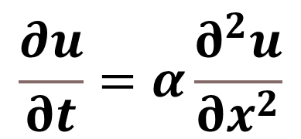
THERMODYNAMICS
Heat Equation
$$\frac{∂u}{∂t}=α\frac{∂^{2}u}{∂x^{2}}$$
Real life examples
Of
Partial Differential equation
u(x,t) is the temperature distribution, a
nd α is the thermal diffusivity
Applications:
To build Cooling systems
To Determine Heat conduction of materials

Slide 32
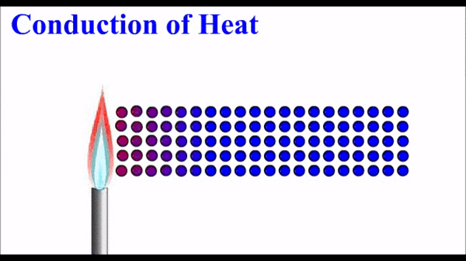
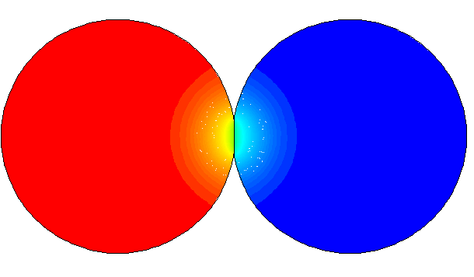
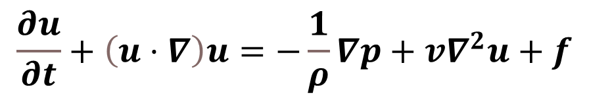

THERMODYNAMICS
Fluid DYNAMICS
Heat Equation
Navier-Stokes Equations:
$$\frac{∂u}{∂t}=α\frac{∂^{2}u}{∂x^{2}}$$
$$\frac{∂u}{∂t}+\left(u⋅∇\right)u=−\frac{1}{ρ}∇p+v∇^{2}u+f$$
u(x,t) is the temperature distribution, a
nd α is the thermal diffusivity
Where u is the velocity field, p is the pressure, ν is the
kinematic viscosity, and f represents body forces.
Applications:
Applications:
To build Cooling systems
To Determine Heat conduction of materials
Used to predict airflow
Used to reduce airforce against aircraft
And automobile.

Slide 33
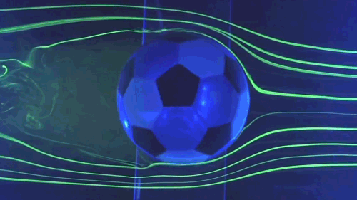
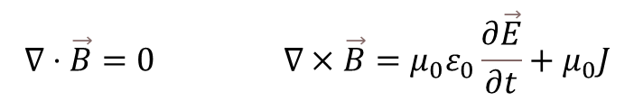
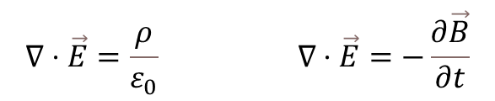


Electromagnetics
THERMODYNAMICS
Fluid DYNAMICS
Maxwell’s equations:
Heat Equation
Navier-Stokes Equations:
$$\frac{∂u}{∂t}=α\frac{∂^{2}u}{∂x^{2}}$$
$$∇⋅\vec{E}=\frac{ρ}{ε_{0}} ∇⋅\vec{E}=−\frac{∂\vec{B}}{∂t}$$
$$\frac{∂u}{∂t}+\left(u⋅∇\right)u=−\frac{1}{ρ}∇p+v∇^{2}u+f$$
$$∇⋅\vec{B}=0 ∇×\vec{B}=μ_{0}ε_{0}\frac{∂\vec{E}}{∂t}+μ_{0}J$$
u(x,t) is the temperature distribution, a
nd α is the thermal diffusivity
Where u is the velocity field, p is the pressure, ν is the
kinematic viscosity, and f represents body forces.
where E is the electric field, B is the magnetic field,
ρ is the charge density, and J is the current density.
Applications:
Applications:
Applications:
Used to design antennas and circuits
To understand Electric and magnetic field
To determine propagation of EM waves
To build Cooling systems
To Determine Heat conduction of materials
Used to predict flow of liquids and gases
Used to reduce air resistance force
on aircraft and automobile.

Slide 34
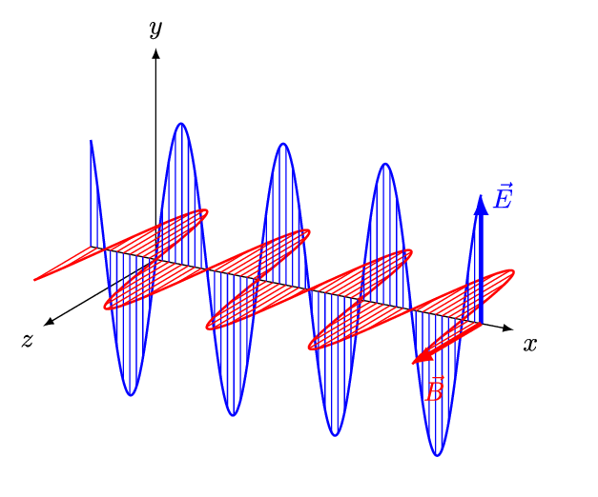
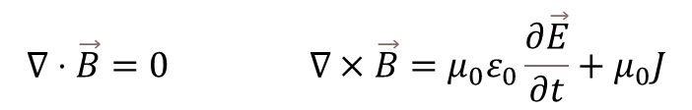

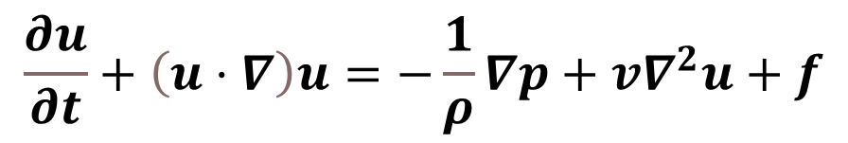
Electromagnetics
Fluid DYNAMICS
Maxwell’s equations:
Navier-Stokes Equations:
$$∇⋅\vec{E}=\frac{ρ}{ε_{0}} ∇⋅\vec{E}=−\frac{∂\vec{B}}{∂t}$$
$$\frac{∂u}{∂t}+\left(u⋅∇\right)u=−\frac{1}{ρ}∇p+v∇^{2}u+f$$
THANK YOU EVERYONE
$$∇⋅\vec{B}=0 ∇×\vec{B}=μ_{0}ε_{0}\frac{∂\vec{E}}{∂t}+μ_{0}J$$
Where u is the velocity field, p is the pressure, ν is the
kinematic viscosity, and f represents body forces.
where E is the electric field, B is the magnetic field,
ρ is the charge density, and J is the current density.
Applications:
Applications:
Used to design antennas and circuits
To understand Electric and magnetic field
To determine propagation of EM waves
Used to predict airflow
Used to reduce airforce against aircraft
And automobile.

Slide 35
THANK YOU EVERYONE
Shahriar M. oishik
Maria nur
2023-3-60-073
2023-3-60-551
Department of CSE
Department of CSE
Afra sultana
Ahmed
2023-3-60-300
2023-3-60-128
Department of CSE
Department of CSE

Slide 36

Shahriar M. oishik
Maria nur
2023-3-60-073
2023-3-60-551
Department of CSE
Department of CSE
Afra sultana
Ahmed
2023-3-60-300
2023-3-60-128
Department of CSE
Department of CSE

